Slide 1
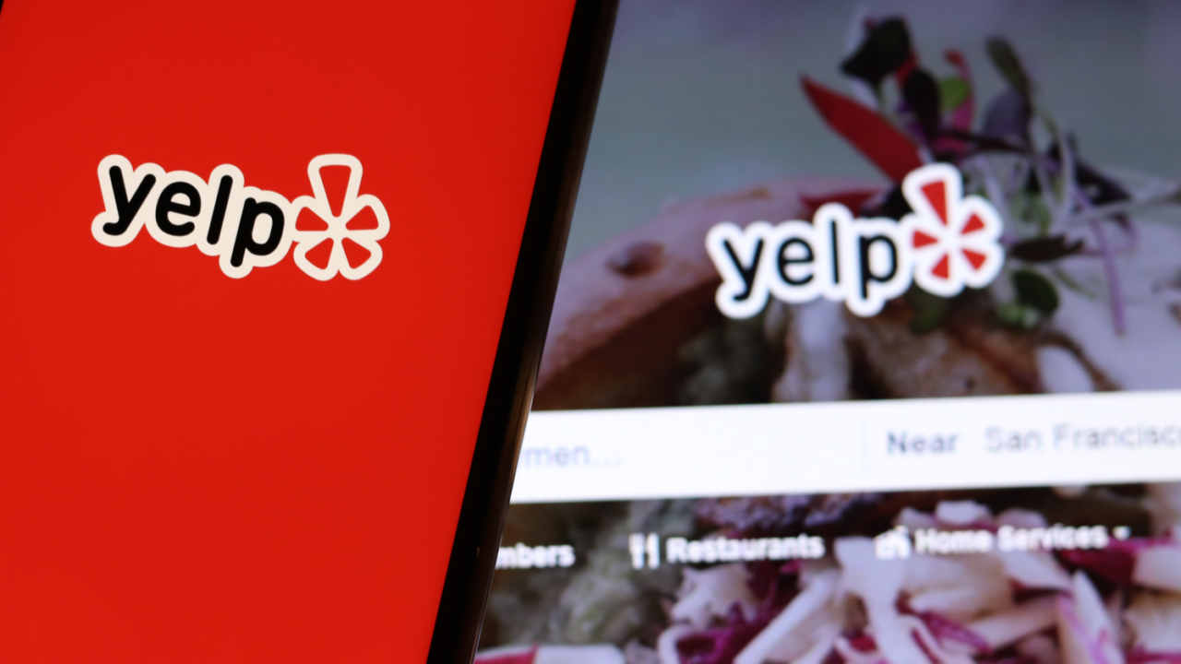
How to Make a Successful Business
—--Based on Yelp Data
Group 2: Xingyu Tang, Feiyun Yan, Kai Shukla

Slide 2
Successful Business
Any business with mean rating of 3.5 or greater with more than a 100 reviews.
Any business meeting this criteria has a 2.5 times greater chance of staying open.

Slide 3
Focus on Bars in the US
Attribute
Reviews
Operating Days & hours.
Location (Shiny app on California Data)

Slide 4
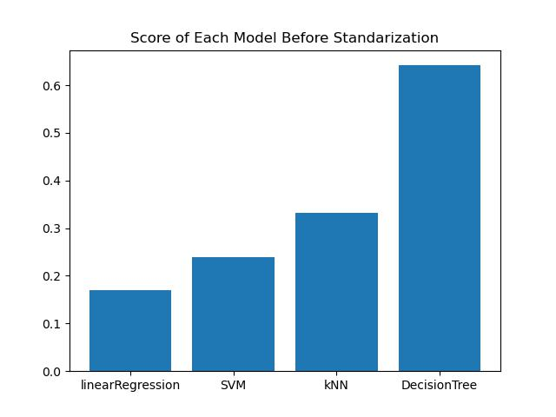

Suggestions Based on Attributes
Focused on Bars in the U.S.
Choose attributes we’re interested
at least 70% bars have
Feature engineering: transform to factor vectors
Data imputation
Missing data: assume this bar doesn’t have this attribute

Slide 5
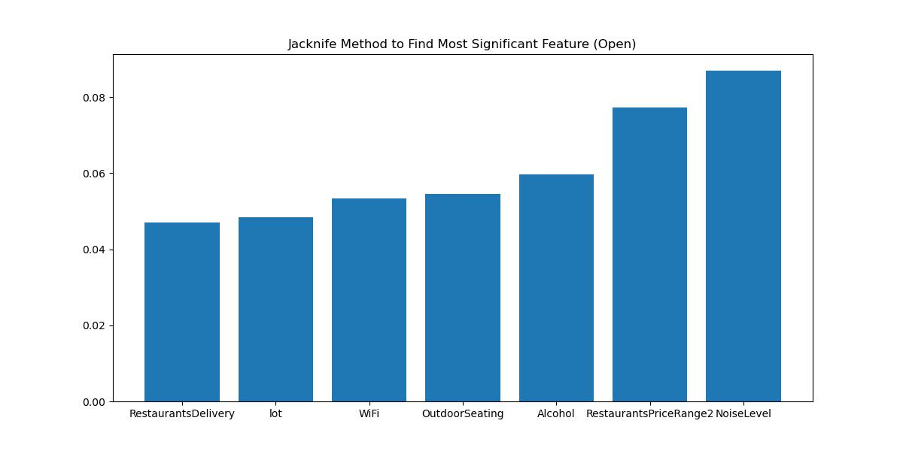
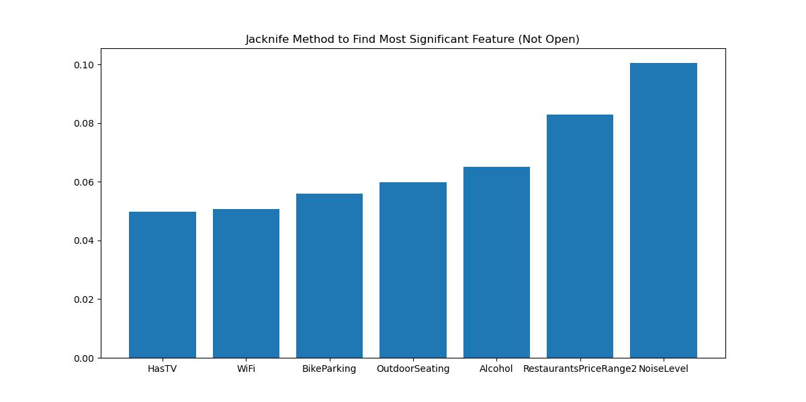
Jacknife Method
More Significant => Larger Reduced Score
Sensitively spot changings of times
Catch up with the tendency
Proper price range
Think highly of alcohol quality and types

Slide 6
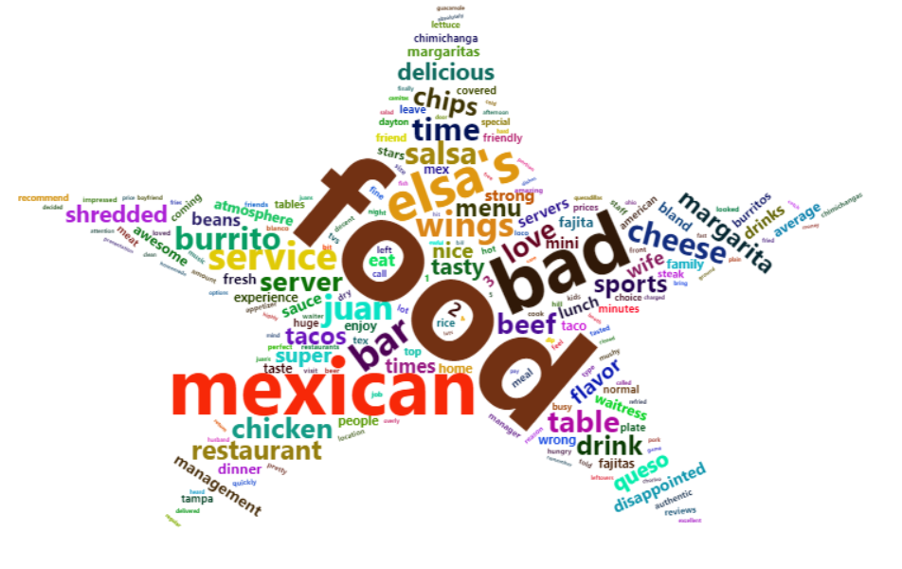
Suggestions Based on Review Words
Word Cloud
Advantages:
Help us extract general customers’ comments quickly
Disadvantages:
Difficult to give specific suggestions

Slide 7
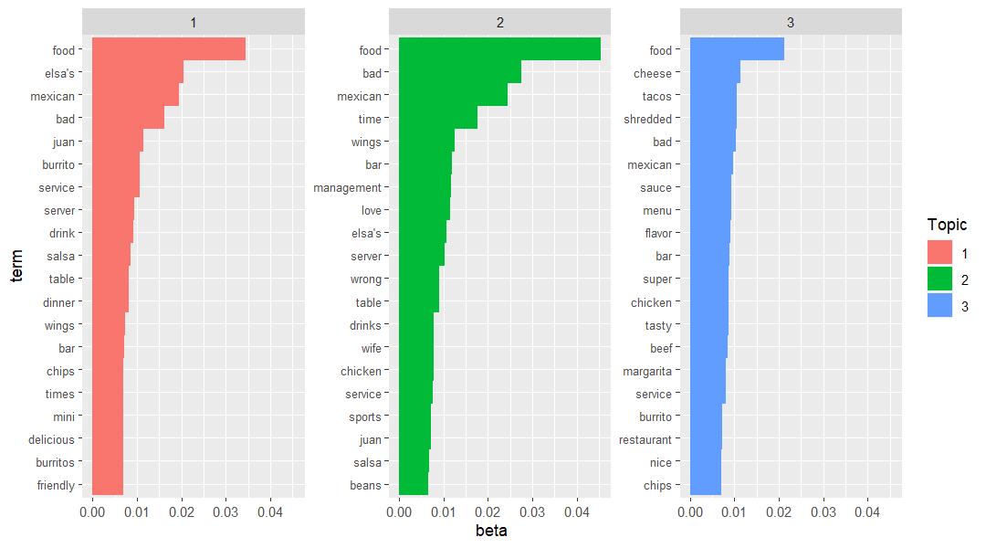
Negative
Positive
LDA Model
Assumption:
More negative words one topic has, more negative this topic is.
Improvements:
Process of Making Wings
Customer Service
Advantages:
Cheese & Tacos
Advice to Visitor

Slide 8
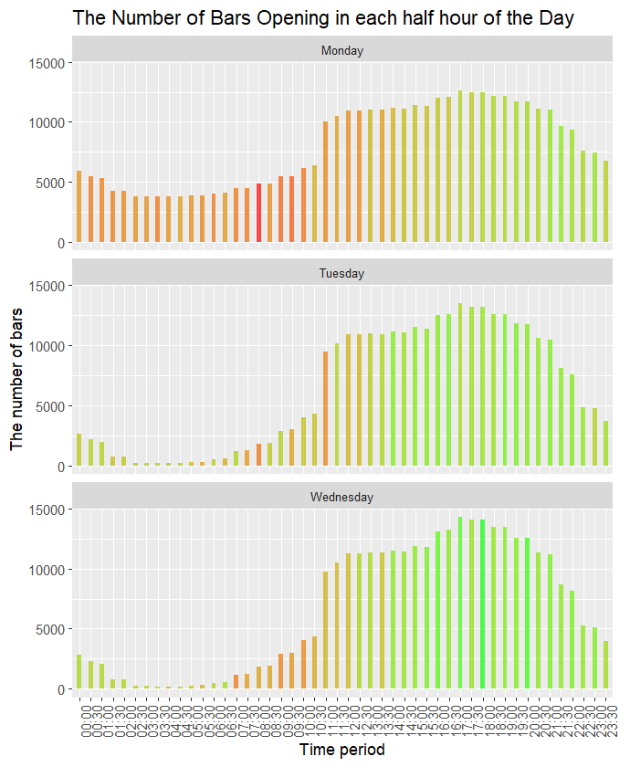
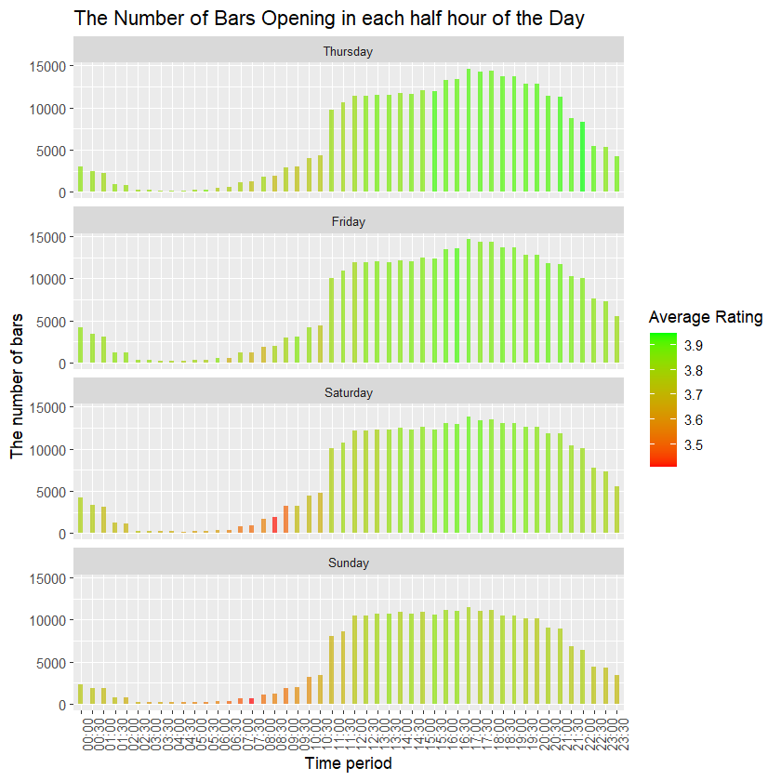

Slide 9
Open Hours <= 25.5
Week<= 5.5
Week <= 6.5
Week <= 1.5
Open Hours <= 8.5
Week <= 1.5
Number of bars open <= 10273
Open hours <=21.5
Rating = 3.717
Open Hours <= 13.5
Rating = 3.801
Open Hours <= 2.5
Rating = 3.709
Open Hours <= 19.5
Rating = 3.603
Open Hours <= 34.5
Rating = 3.829
Open Hours <= 28.5
Rating = 3.879
Open Hours <= 45.5
Rating =3.755
Open Hours <= 34.5
Rating = 3.802

Slide 10
Shiny App
https://bodyfatprediction.shinyapps.io/yelp_data_dashboard/

Slide 11
Discussion
Final target: Apply our model to all categories of business
for any category of business (denoted as 𝓗)
Analyze which attributes are significant and what time has more customers through decision tree model
Conclude which aspect 𝓗 needs to be improved according to beta values of typical emotional words through LDA model

Slide 12
Thank you

